Slide 1
Generative Adversarial Networks

Slide 2
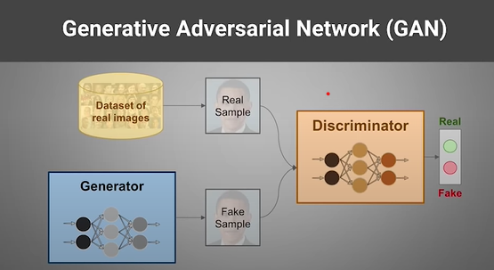
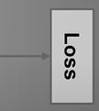
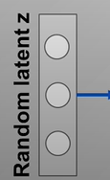
Generative Adversarial Network (GAN)
Generative Adversarial Networks use a generator network to generate new samples of data and a discriminator network to evaluate the generator’s performance
The Generator network is able to take random noise and map it into images such that the discriminator cannot tell which images came from the dataset and which images came from the generator.
The discriminator is a binary classifier. And finally, the flattened activation maps mapped to a probability output to predict if the image is real or fake.

Slide 3
What is Deep Convolutional Generative Adversarial Networks (DCGAN)?
Deep Convolutional Generative Adversarial Networks or DCGANs are the ‘image version’ of the most fundamental implementation of GANs.
DCGAN is one of the popular and successful network design for GAN.
It mainly composes of convolution layers.
It uses convolutional stride and transposed convolution for the downsampling and the upsampling.

Slide 4
Research Question
Generate new images from existing images by using different Generator and Discriminator Models

Slide 5
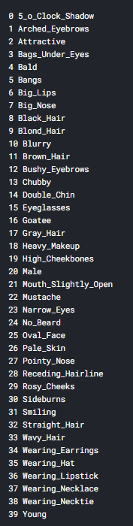
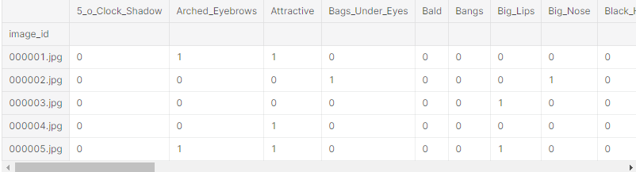
CelebFaces Attributes (CelebA) Dataset
202,599 number of face images
40 binary attribute annotations per image

Slide 6
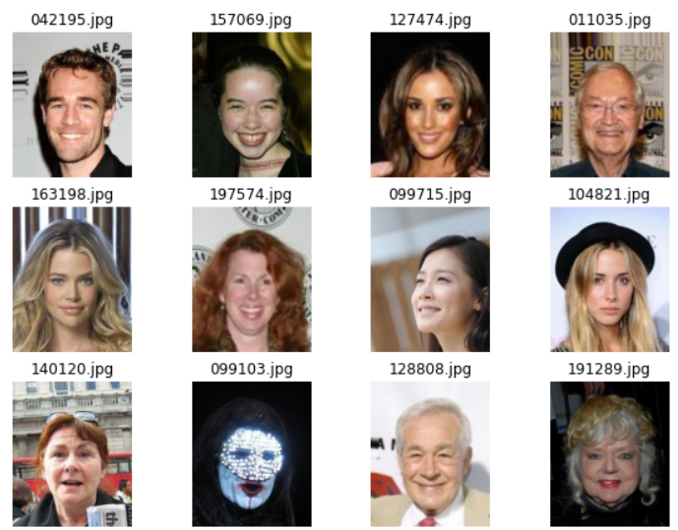
CelebFaces Attributes (CelebA) Dataset
Real Samples

Slide 7
Parameters
Train
n_images=10000
epochs=50
batch_size= 32
img_shape= (128,128,3)
latent_dim=100 (noise dimension)
Optimizer (GAN)
RMSprop with learning rate 0.0004
Optimizer (Discriminator)
Adam Optimizer with learning rate 0.0002.
Loss
Binary Cross Entropy

Slide 8
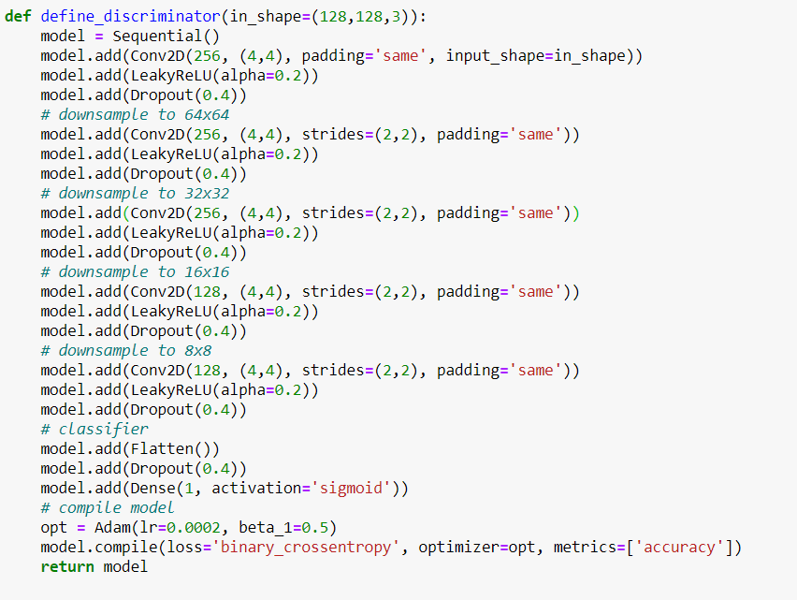
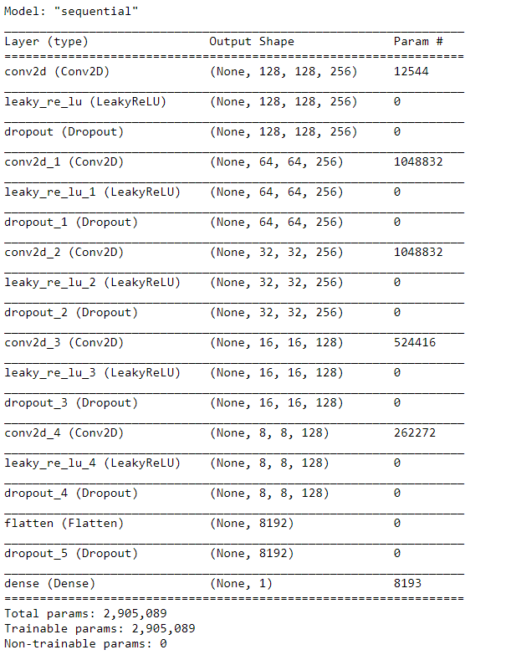
Discriminator Model 1
Notes:
The discriminator is nothing but a binary classifier that consists of several convolution layers (like any other image classification tasks). And finally, the flattened activation maps mapped to a probability output to predict if the image is real or fake.

Slide 9
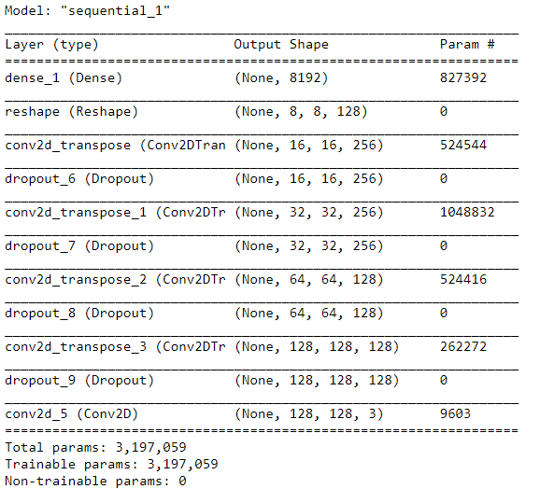
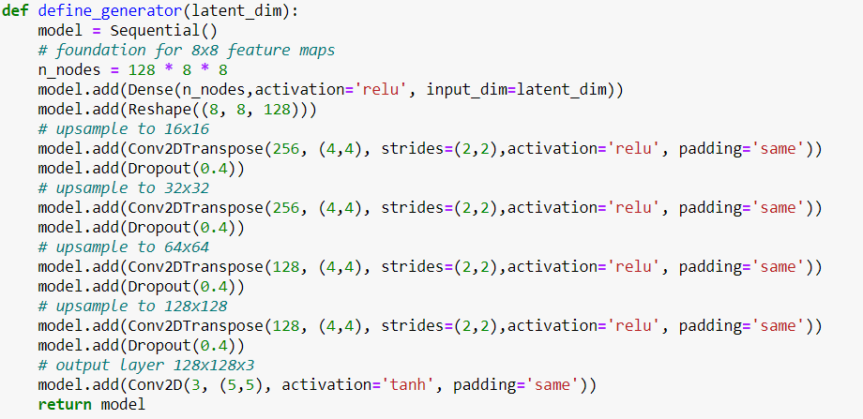
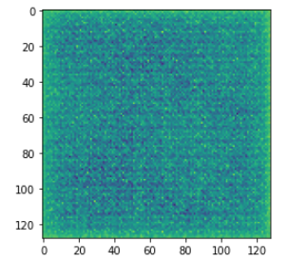
Generator Model 1
The generator model mainly consists of Deconvolution layers or more accurately, Transposed Convolution layers that basically perform the reverse of a Convolution operation.

Slide 10
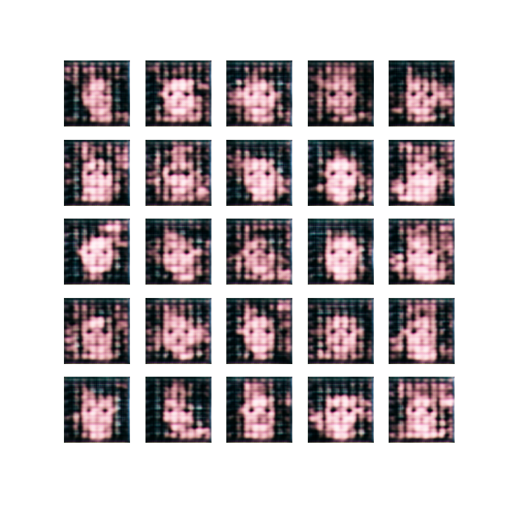
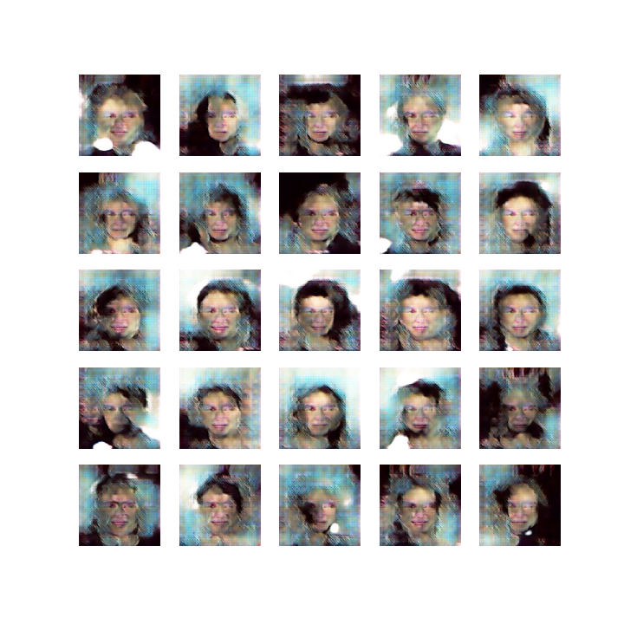
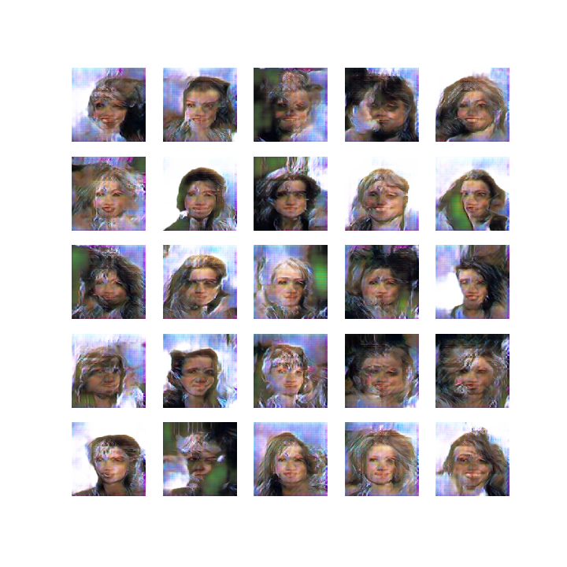
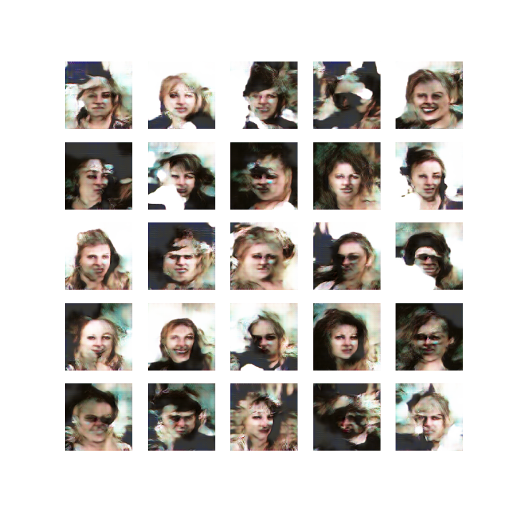
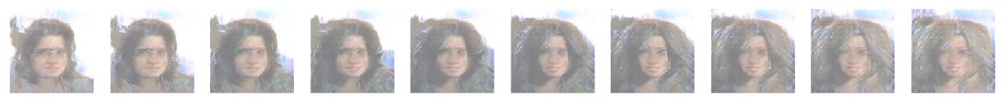
Generated Images
1. Epoch 10. Epoch 40. Epoch 50. Epoch

Slide 11
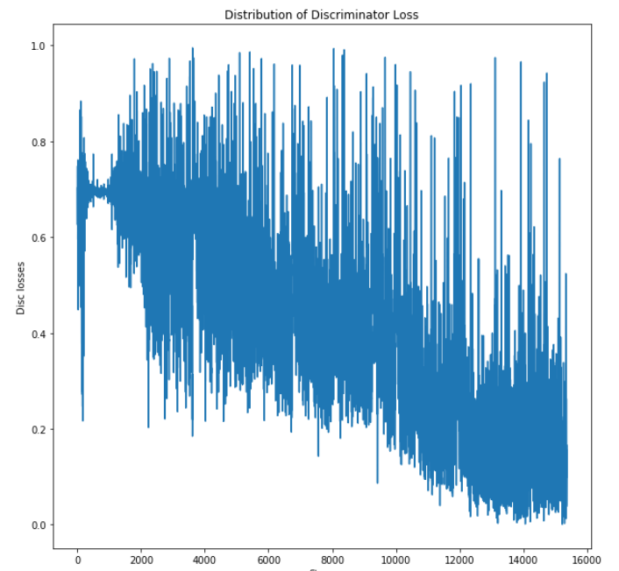
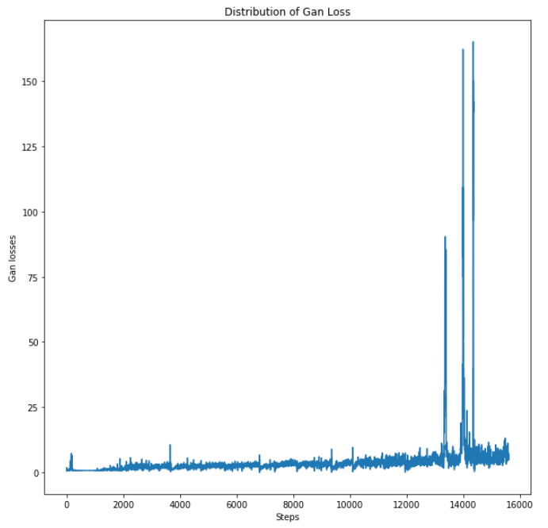
Discriminator and Gan Losses for each Batch

Slide 12
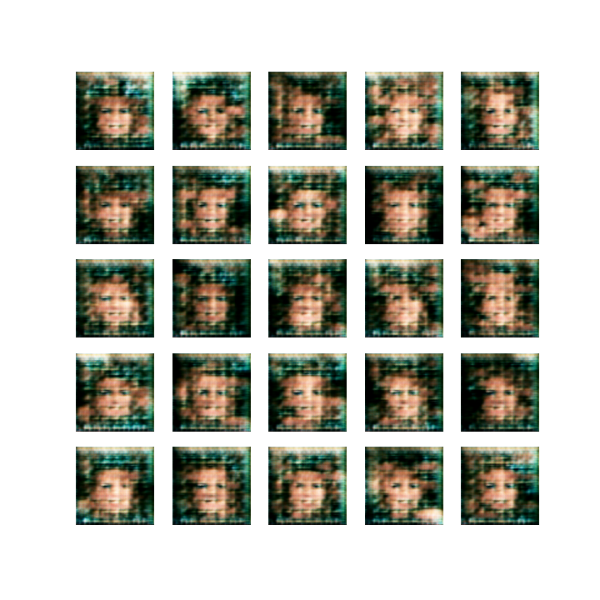
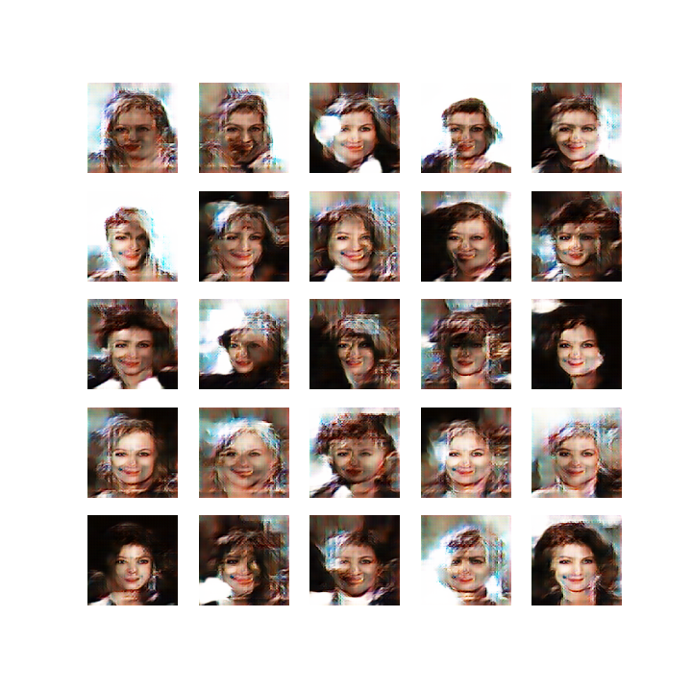
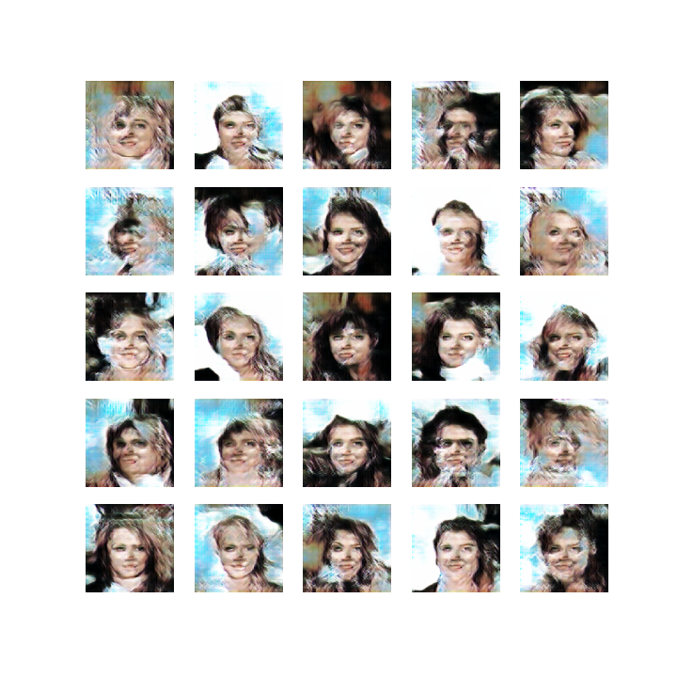
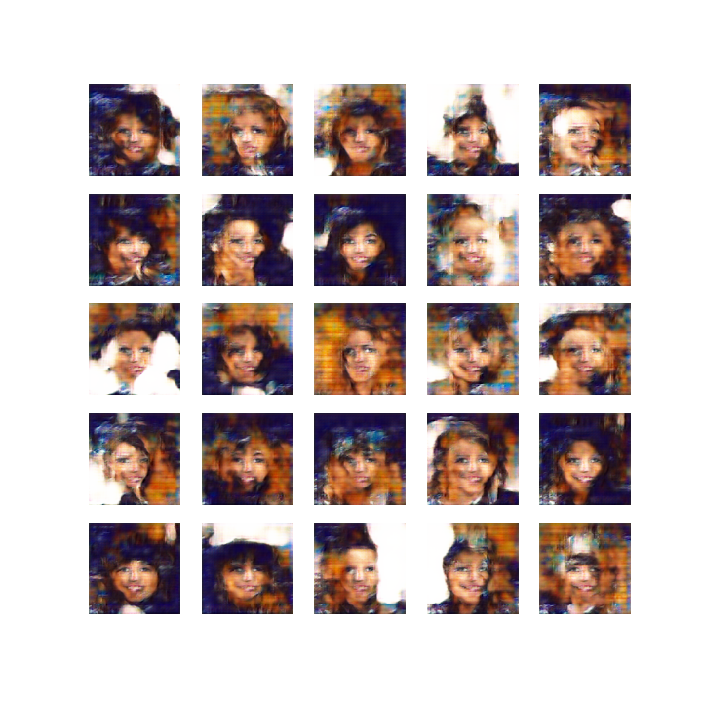
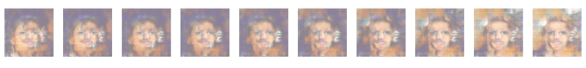
Generated Images with same Generator and Discriminator Models
1. Epoch 10. Epoch 40. Epoch 50. Epoch
n_images=20000
epochs=50
batch_size= 64 (32 real+ 32 fake)
img_shape= (128,128,3)

Slide 13
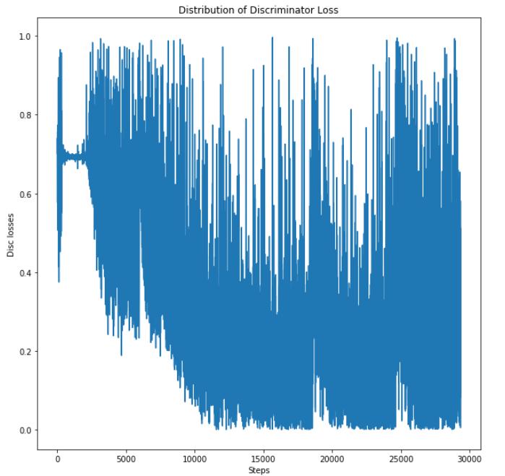
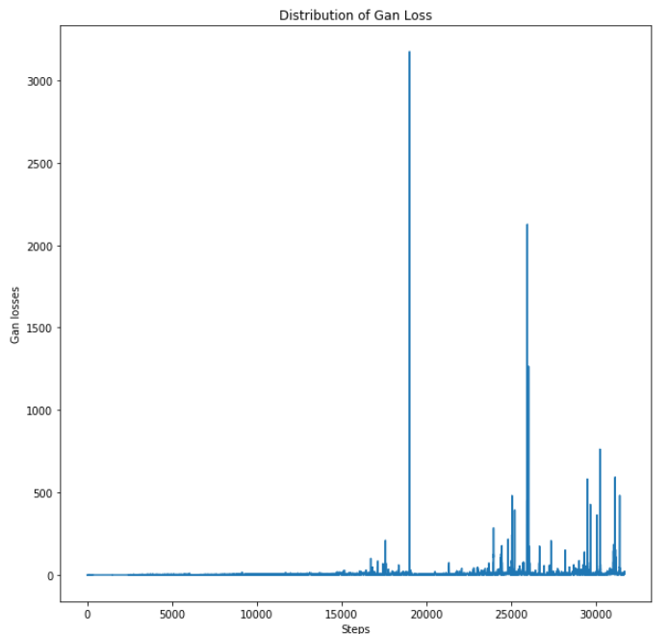
Discriminator and Gan Losses for each Batch

Slide 14
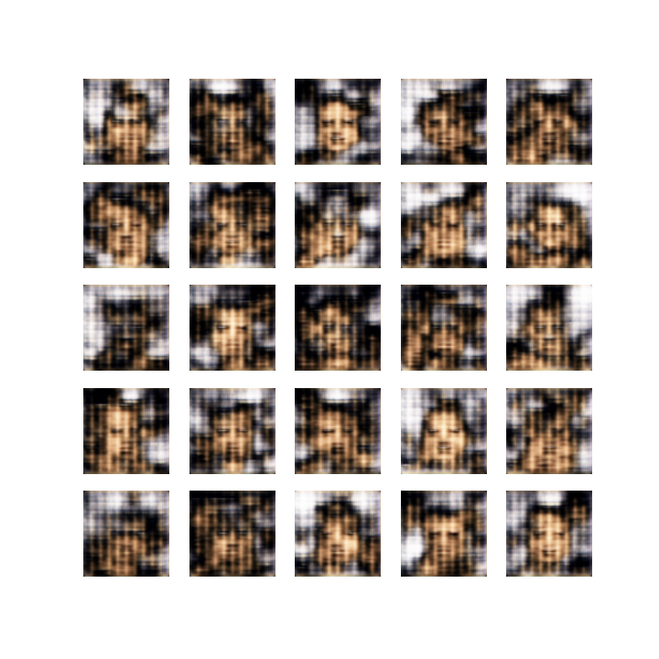
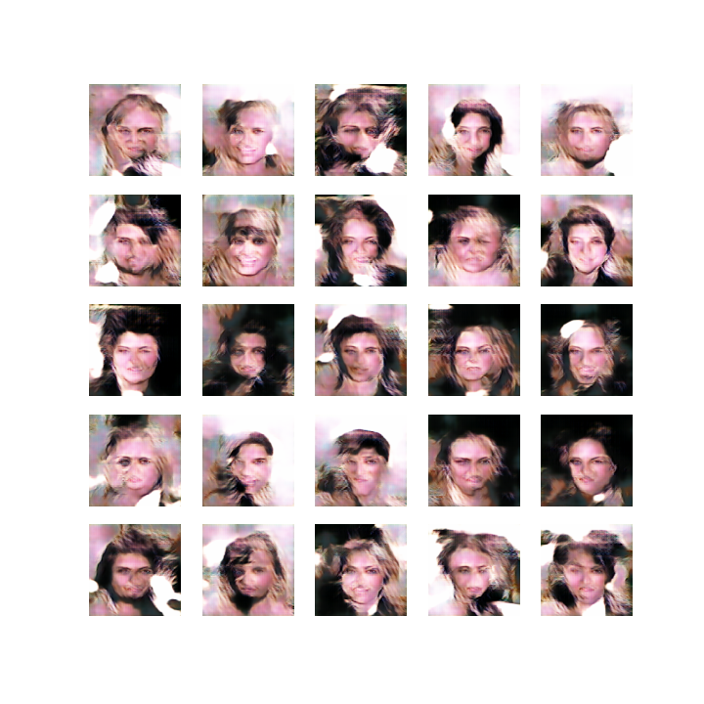
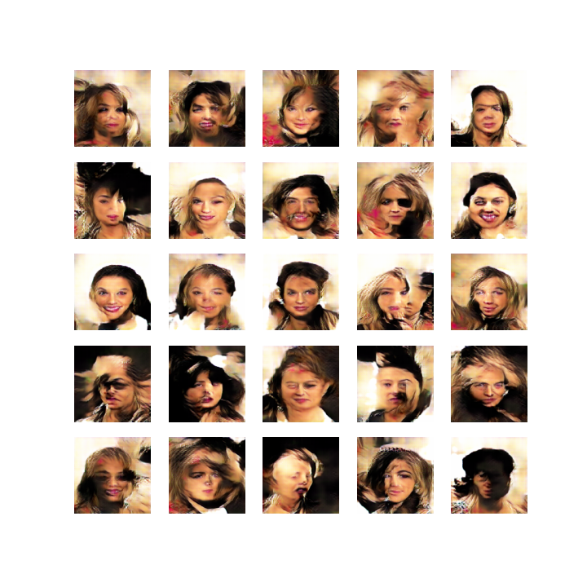
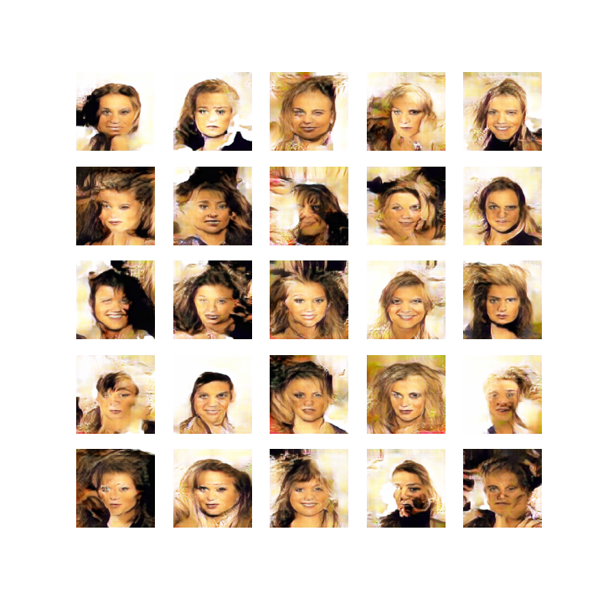
Generated Images
1. Epoch 10. Epoch 40. Epoch 50. Epoch
n_images=10000
epochs=50
batch_size= 64 (32 real+ 32 fake)
img_shape= (160,160,3)

Slide 15
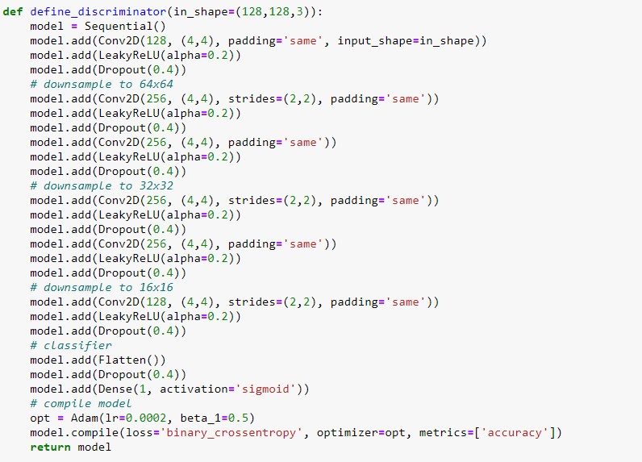
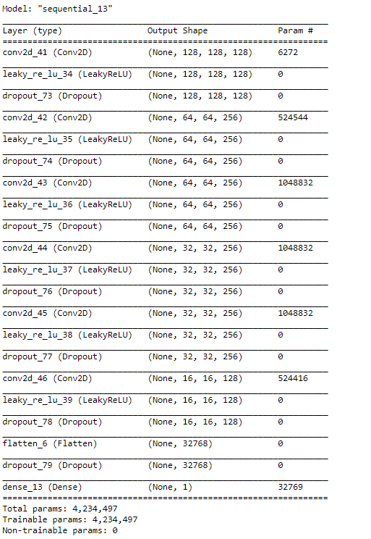
Discriminator Model 2
Notes:
The discriminator is nothing but a binary classifier that consists of several convolution layers (like any other image classification tasks). And finally, the flattened activation maps mapped to a probability output to predict if the image is real or fake.

Slide 16
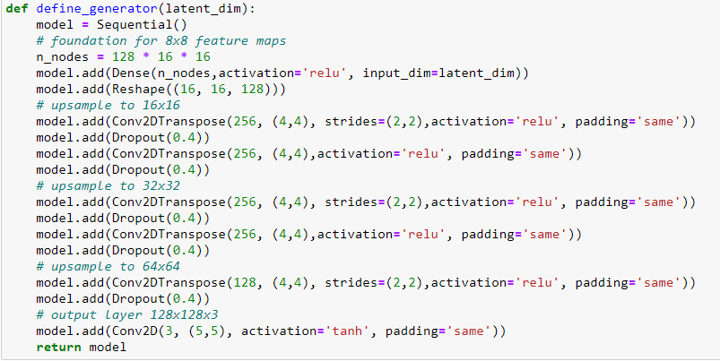
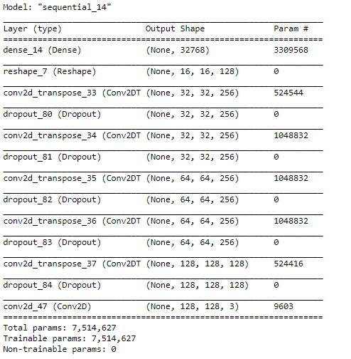
Generator Model 2

Slide 17
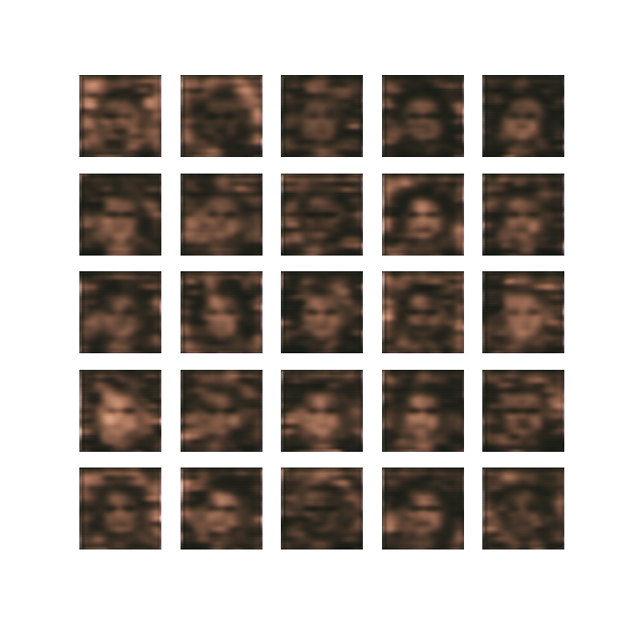
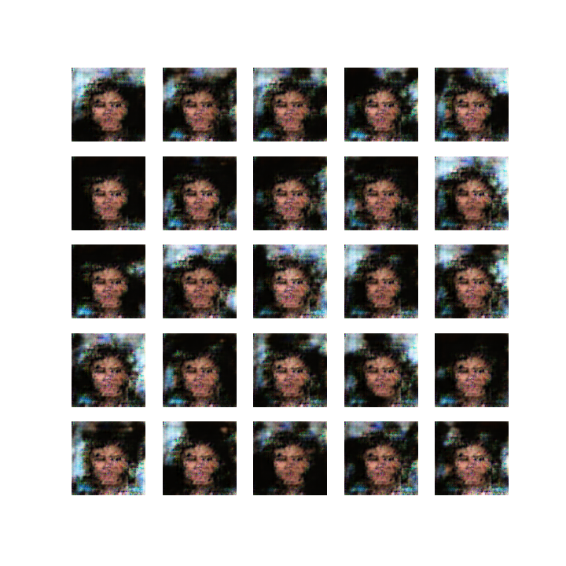
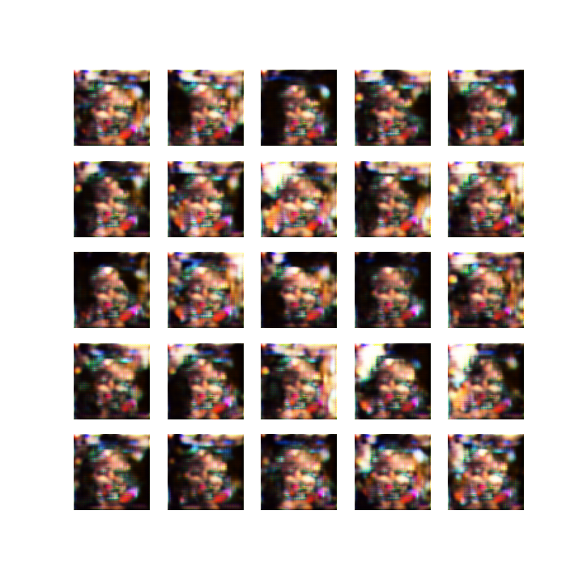
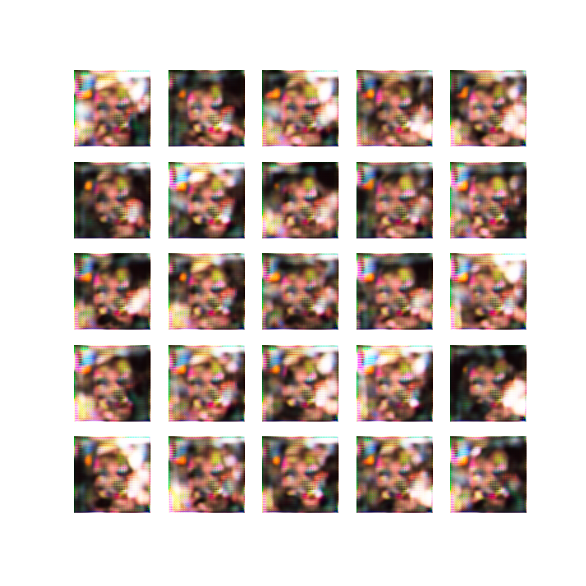
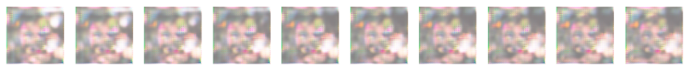
Generated Images
1. Epoch 10. Epoch 40. Epoch 50. Epoch
n_images=20000
epochs=50
batch_size= 128 (64 real+ 64fake)
img_shape= (128,128,3)

Slide 18
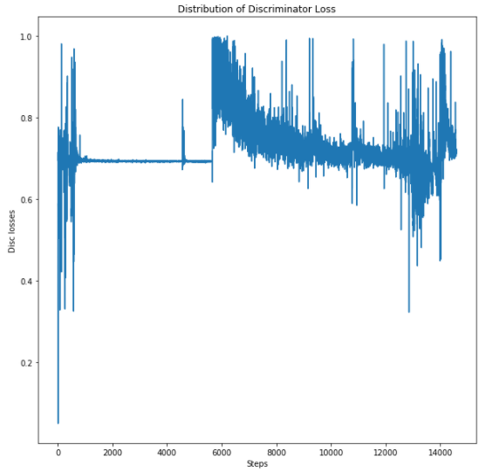
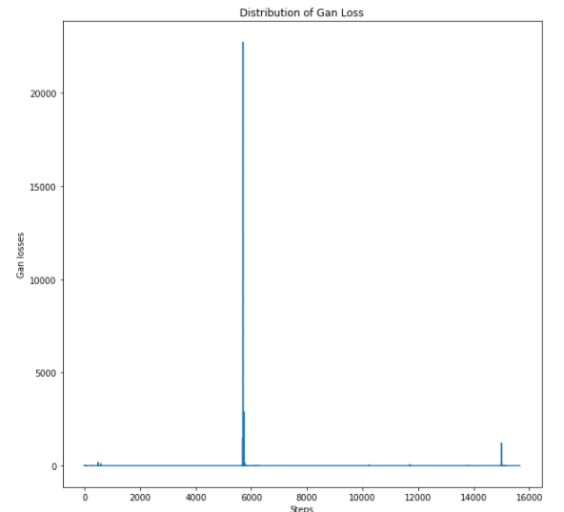
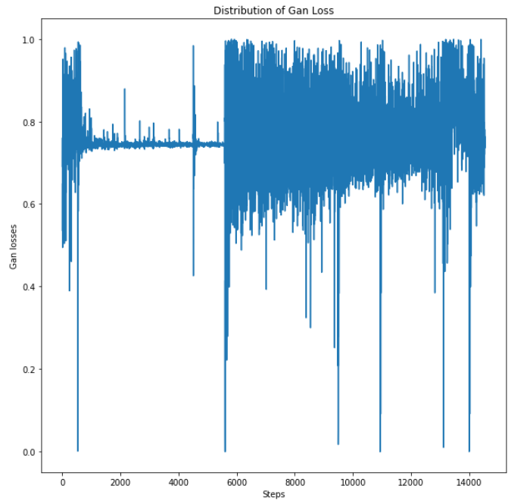
Discriminator and Gan Losses for each Batch

Slide 19
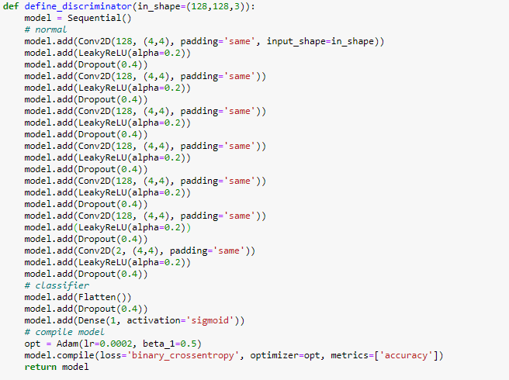
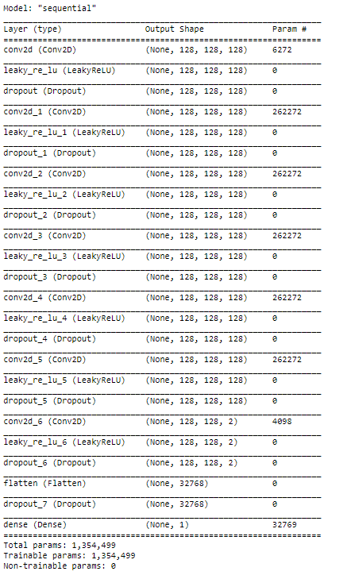
Discriminator Model 3 (without stride)
Notes:
The discriminator is nothing but a binary classifier that consists of several convolution layers (like any other image classification tasks). And finally, the flattened activation maps mapped to a probability output to predict if the image is real or fake.

Slide 20
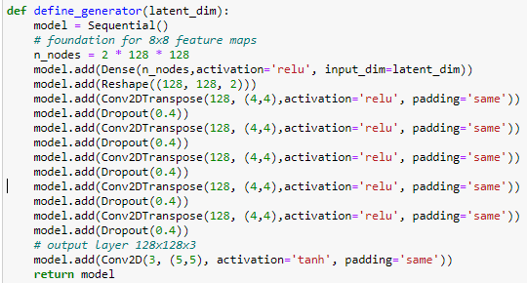
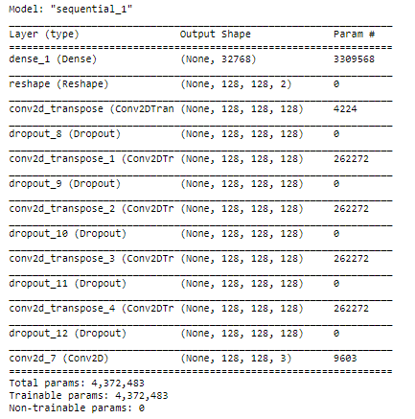
Generator Model 3 (without stride)

Slide 21
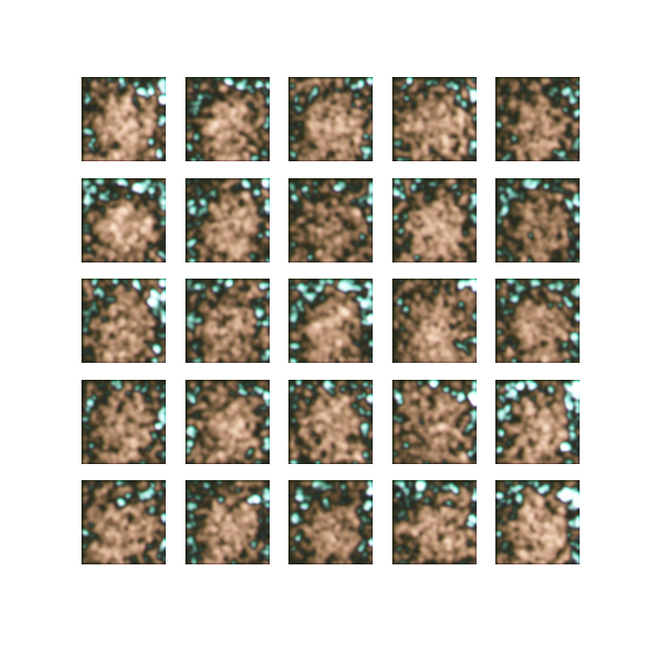
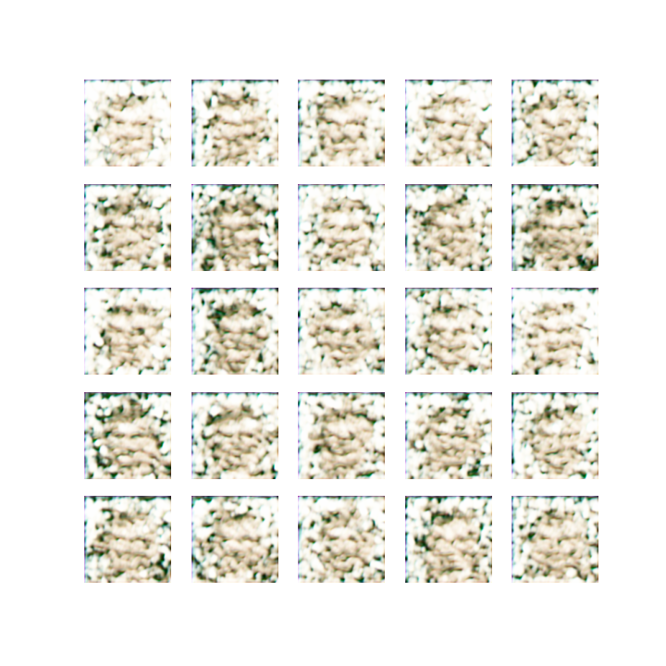
Generated Images
1. Epoch 10. Epoch 40. Epoch 50. Epoch
n_images=20000
epochs=50
batch_size= 128 (64 real+ 64fake)
img_shape= (128,128,3)
After 10 Epochs I stopped running model, since it takes too much time to run the model with respect to other models.

Slide 22
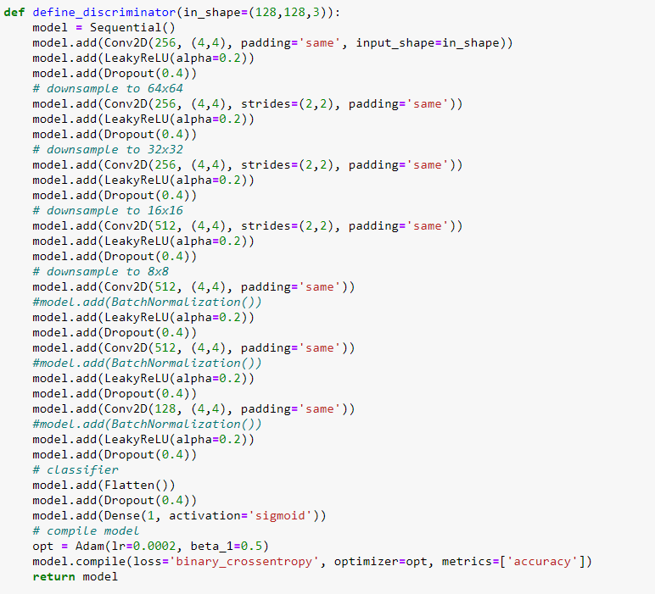
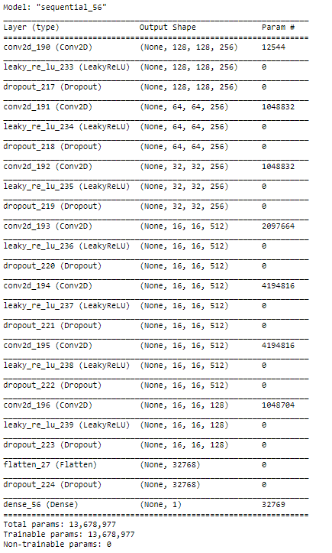
Discriminator Model 4
Notes:
The discriminator is nothing but a binary classifier that consists of several convolution layers (like any other image classification tasks). And finally, the flattened activation maps mapped to a probability output to predict if the image is real or fake.

Slide 23
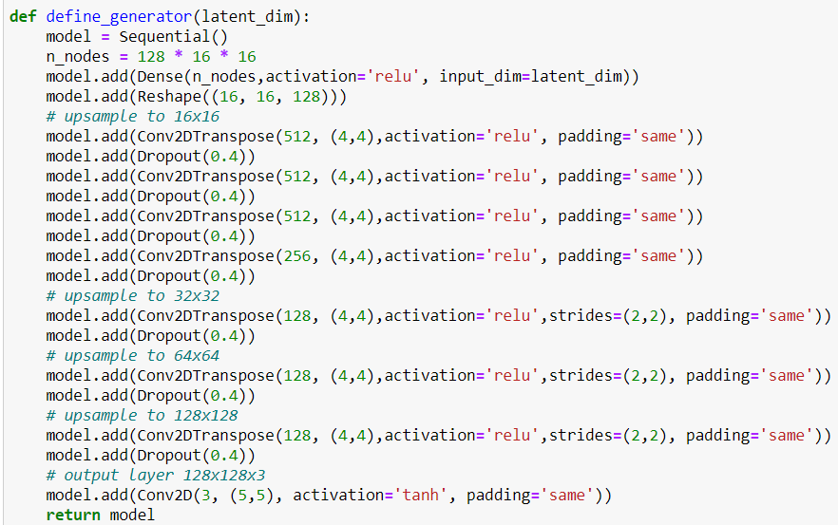

Generator Model 4

Slide 24



Generated Images
10. Epoch 40. Epoch 50. Epoch
n_images=10000
epochs=50
batch_size= 64 (64 real+ 64fake)
img_shape= (128,128,3)

Slide 25


Discriminator and Gan Losses for each Batch

Slide 26



Discriminator Model 5 with Pretrained Model
Notes:
The discriminator is nothing but a binary classifier that consists of several convolution layers (like any other image classification tasks). And finally, the flattened activation maps mapped to a probability output to predict if the image is real or fake.

Slide 27


Generator Model 5

Slide 28




Generated Images
10. Epoch 40. Epoch 50. Epoch 100 Epoch
n_images=10000
epochs=100
batch_size= 64 (64 real+ 64fake)
img_shape= (128,128,3)

Slide 29
Results
Using Strides in Models gives better solutions.
It is suggested using BatchNormalization for both Generator and Discriminator models, but I got realy bad results when I used it.
LeakyRelu Activation is highly suggested.
With higher Number of Images, Batch size and number of Epochs, better solution can be obtained.
Pretrained Models didn‘t produce perfect results.

